Slide 1

MOVIE TIME
Featuring an Exploration of Movie Data Over Time with Bonus Content

Slide 2
Movie Data Analysis
1
2
3
How has movie revenue and popularity changed over time?
Where are movies produced? What languages are used in the movies?
Can data be visualized without using numbers? How, when, and why?

Slide 3
API and Data Munging
1
2
3
4
API calls to create the data set
Dropping columns with a significant amount missing data
Reviewing columns for inconsistent data and either dropping or converting
Filling data

Slide 4
REVENUE AND BUDGET ANALYSIS

Slide 5
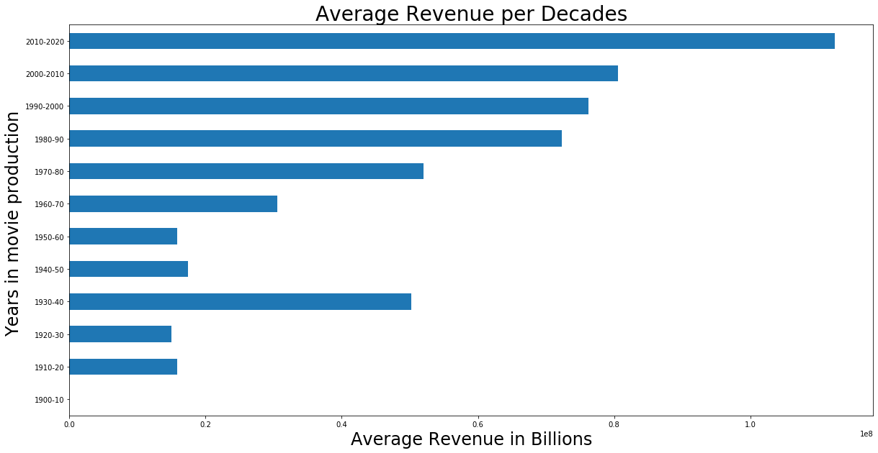
Average $ Revenue per Decade

Slide 6
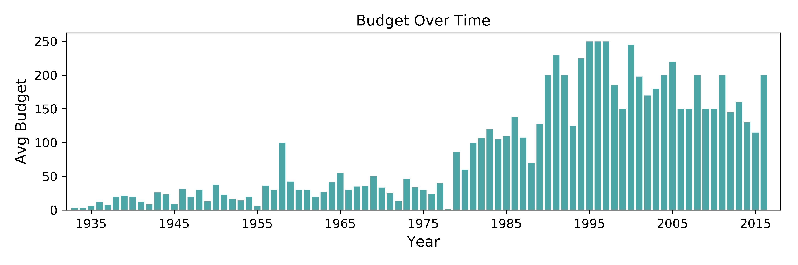
Budget Over Time

Slide 7
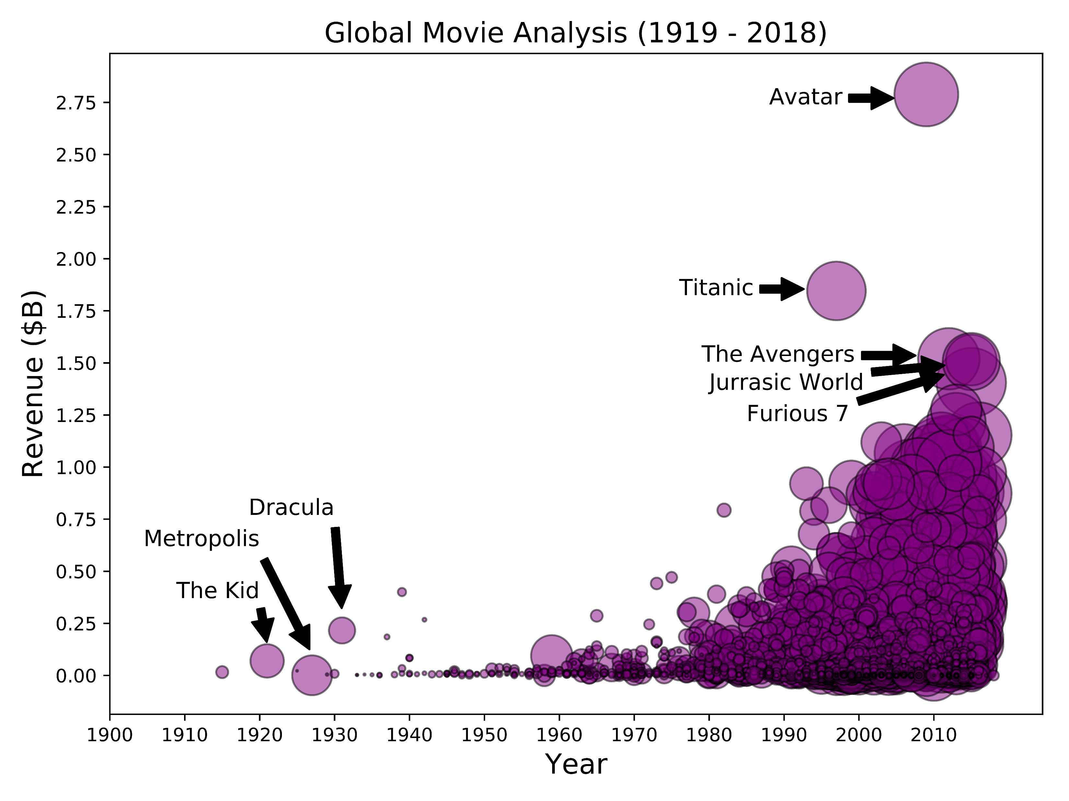
Global Movie Analysis (1919 – 2018)

Slide 8
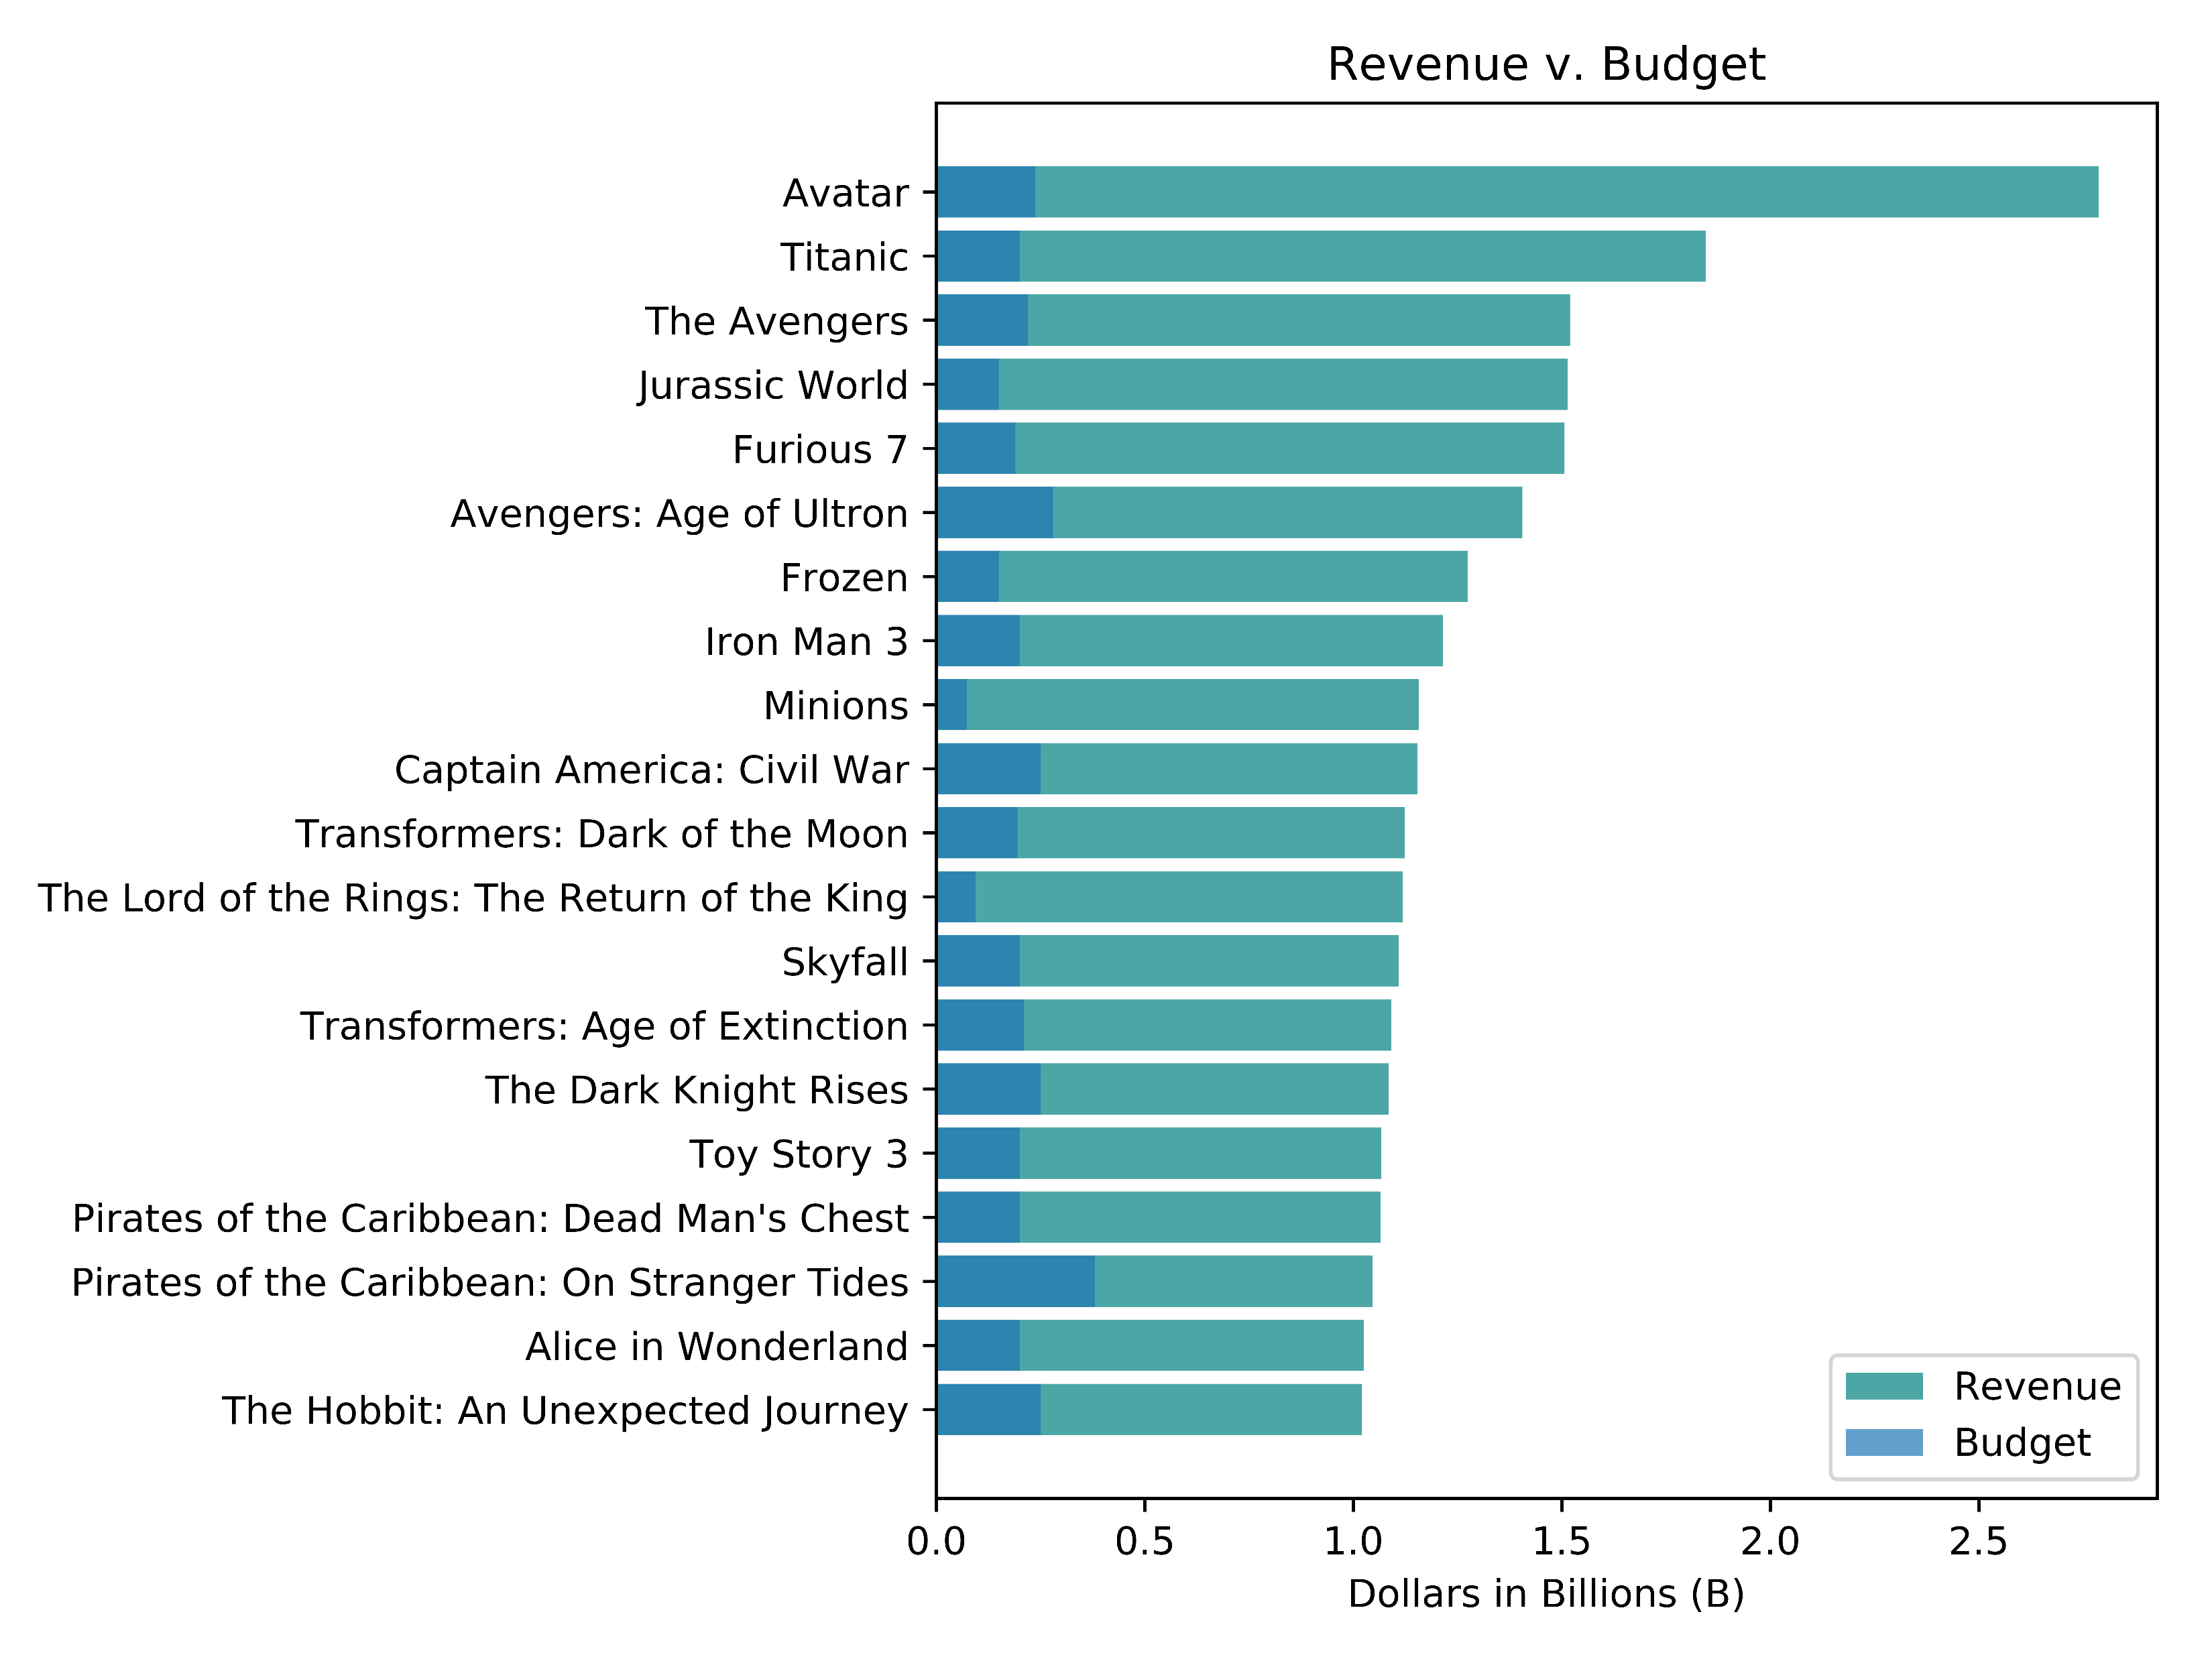
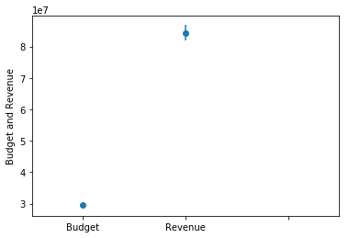
Revenue v. Budget

Slide 9
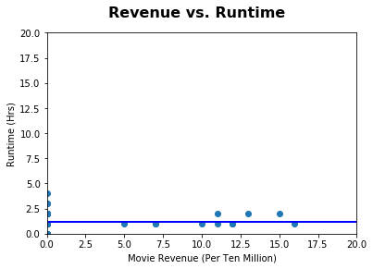

Revenue v. Runtime
a

Slide 10
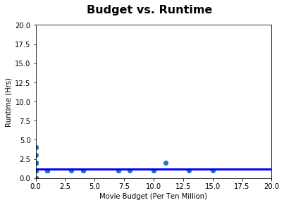

Budget v. Runtime

Slide 11
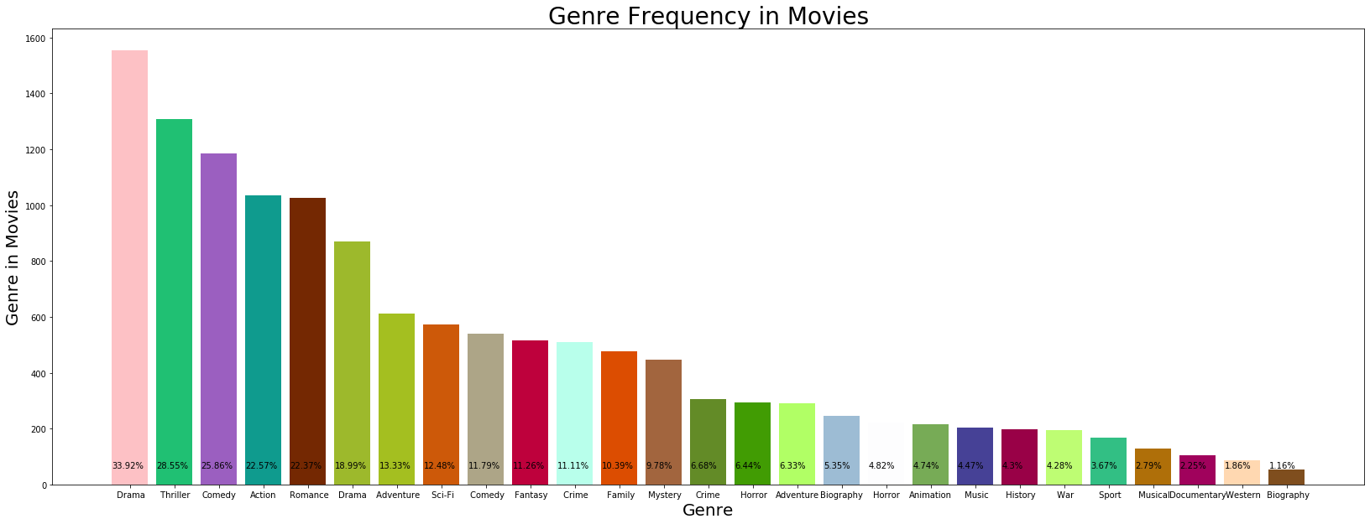
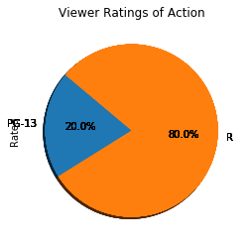
GENRE ANALYSIS

Slide 12
LANGUAGE ANALYSIS

Slide 13
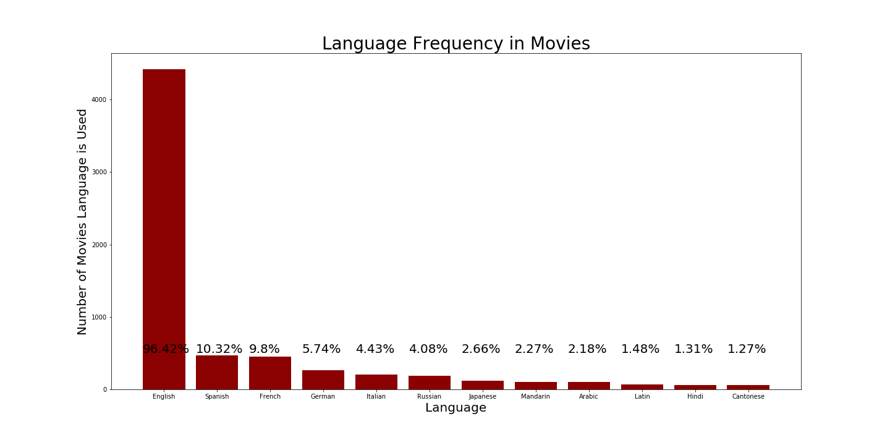
Language Frequency in Movies

Slide 14
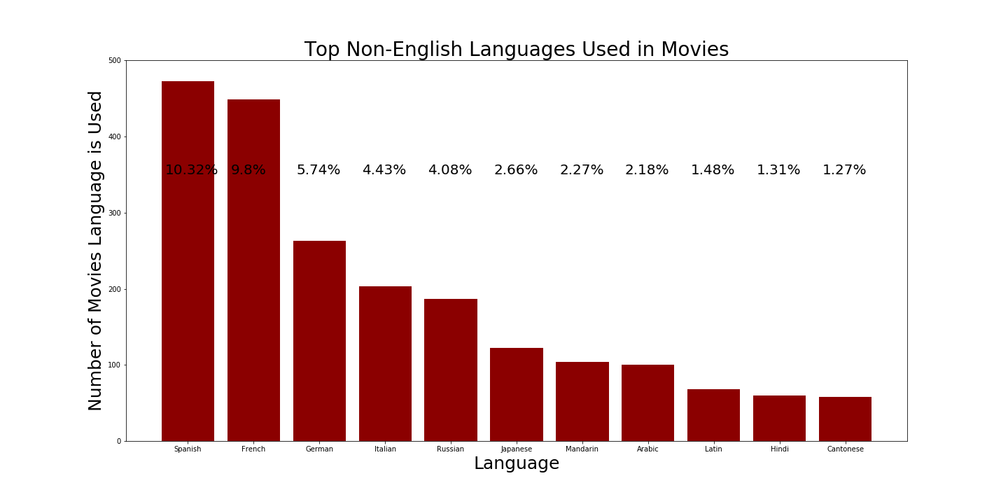
Top Foreign Languages Used in Movies

Slide 15
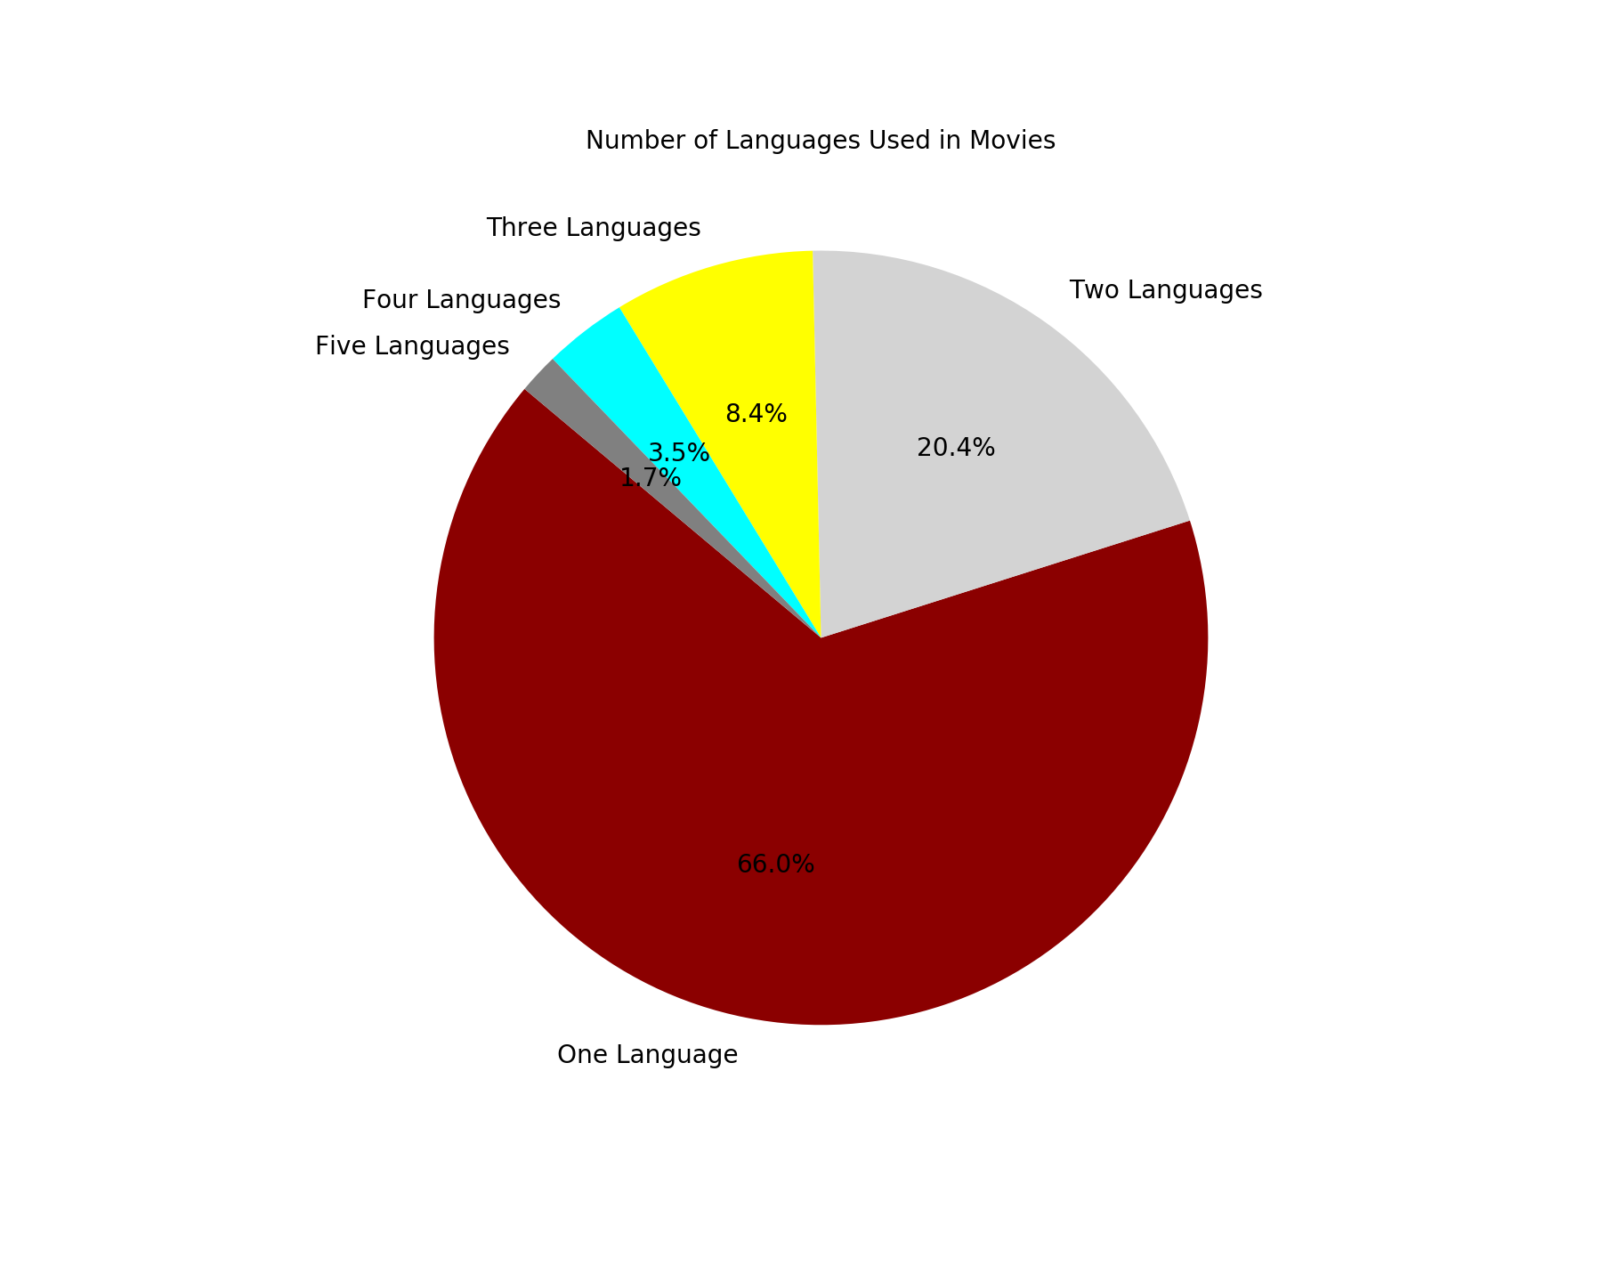
Number of Languages Used in Movies

Slide 16
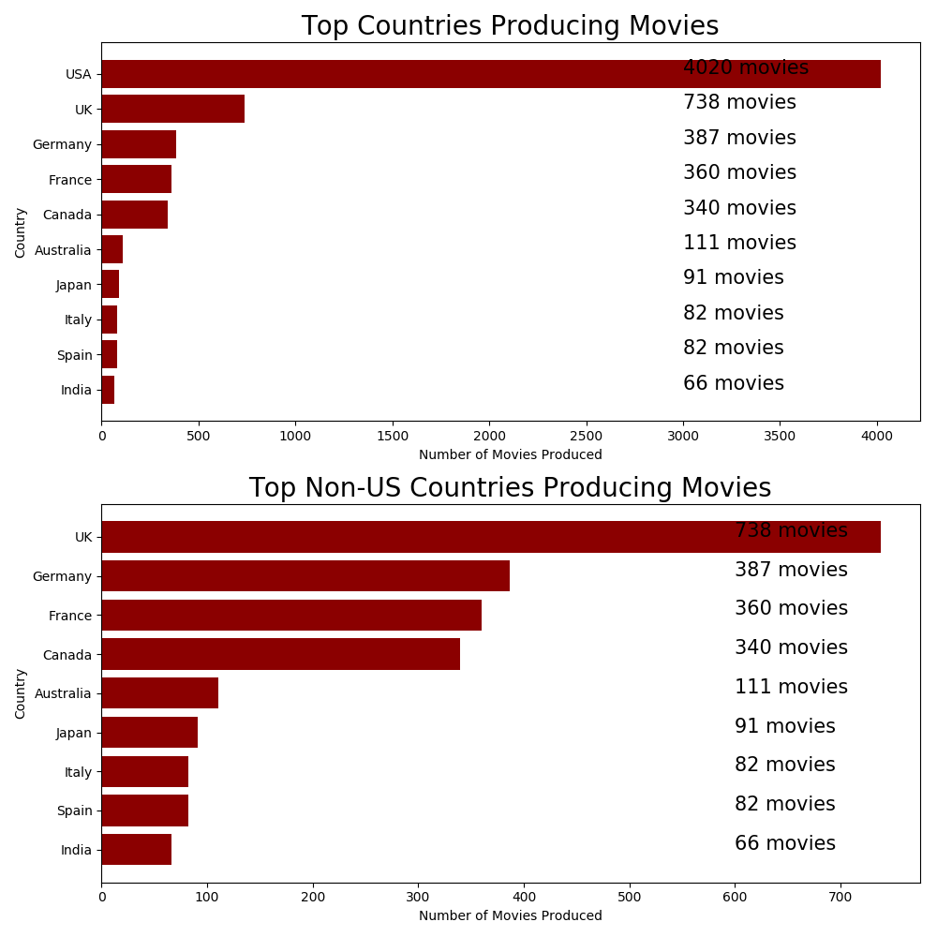
Top Countries Producing Movies

Slide 17
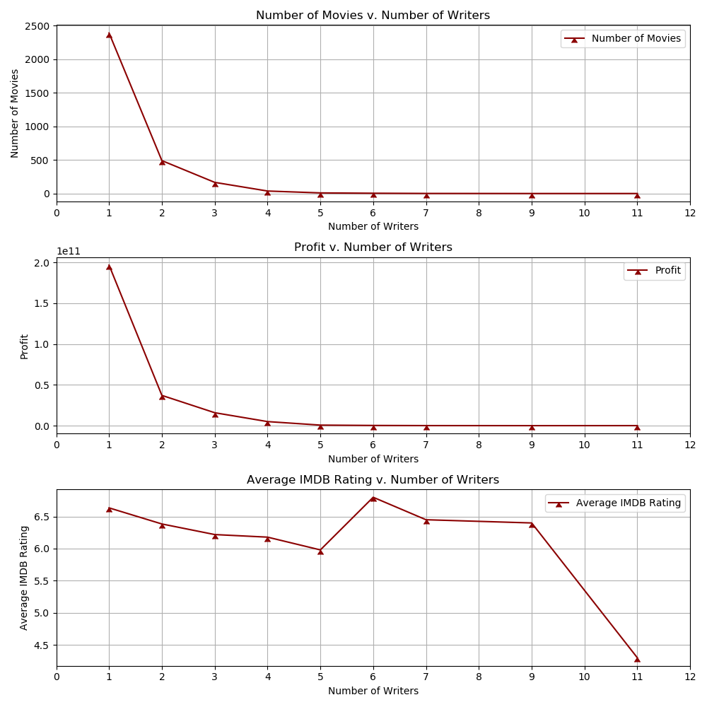
Number of Movies v. Number of Writers

Slide 18
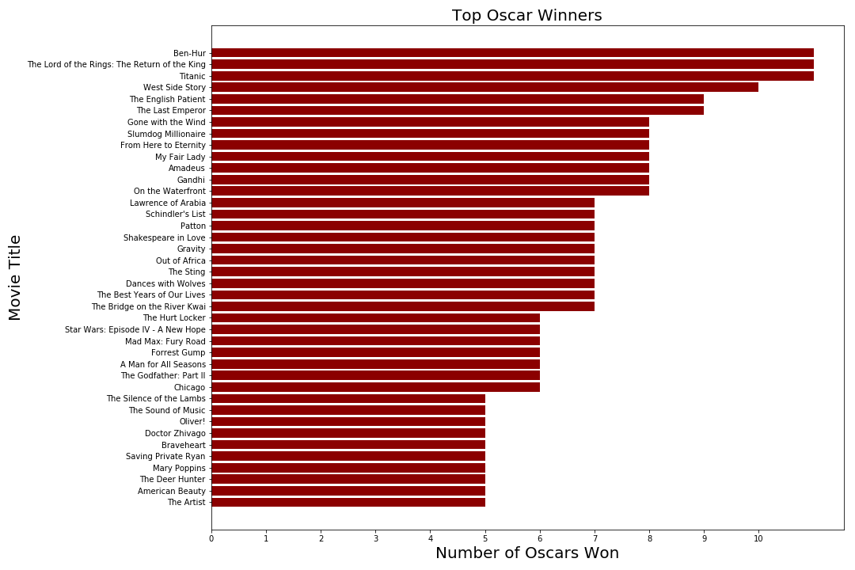
Top Oscar Winners

Slide 19


Genre and Title Frequency

Slide 20


Language Frequency

Slide 21


Country and Rated Frequency

Slide 22
Key Takeaways
The number of movies produced and profit has increased with each passing decade(without adjusting for inflation).
There has been a significant increase in movie budgets over time.
The most frequent languages occurring in movies are English, Spanish, French, and German.

